Slide 1
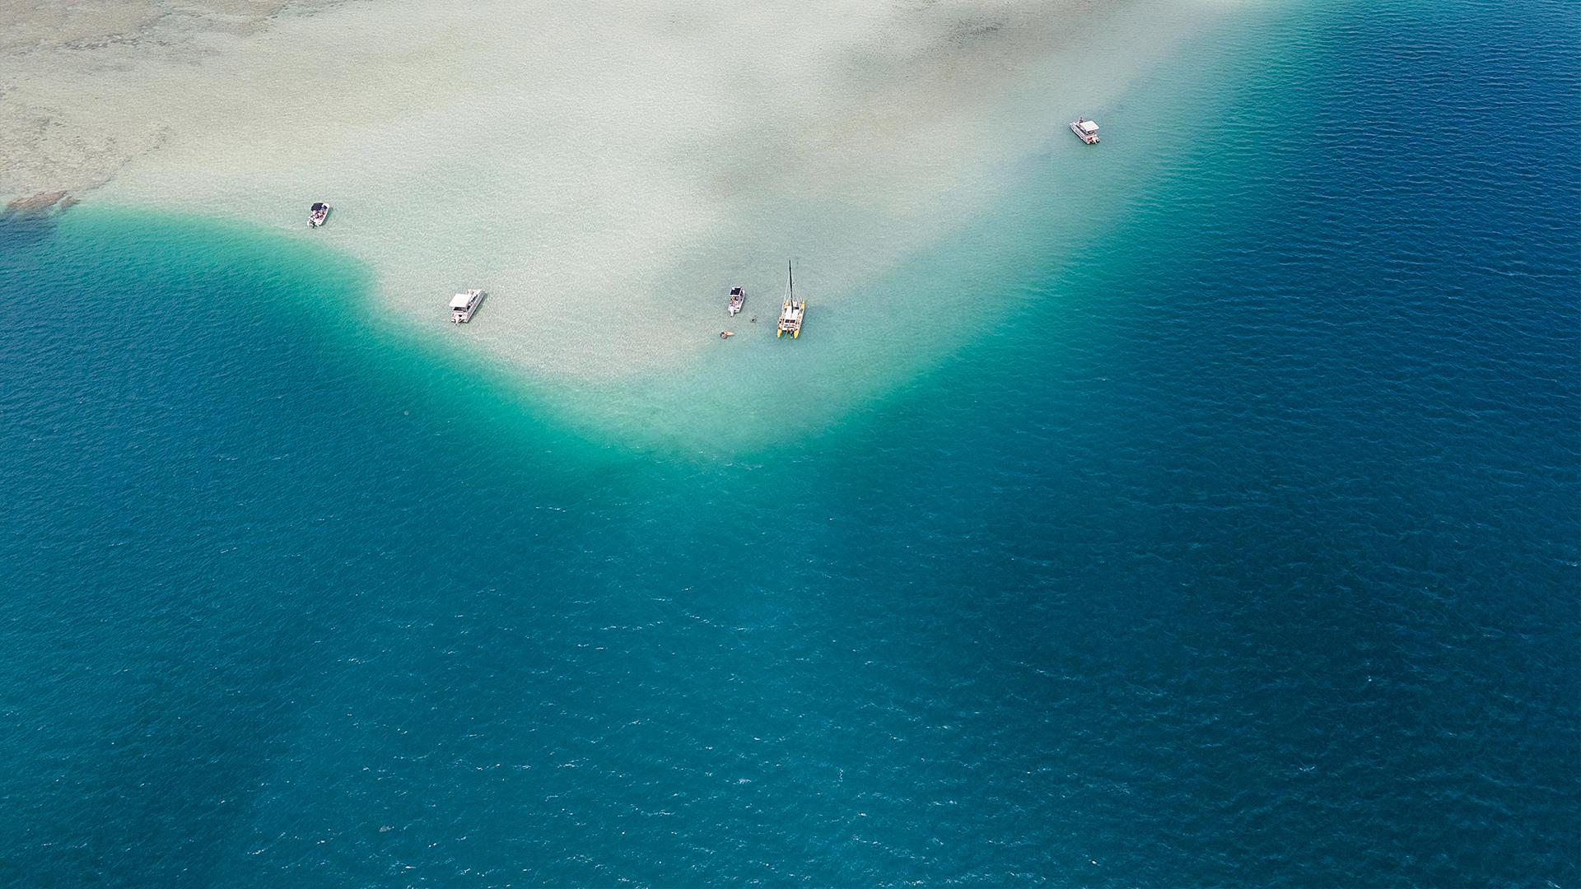
Jacques-Yves Cousteau
a French naval officer, oceanographer, filmmaker and author

Slide 2
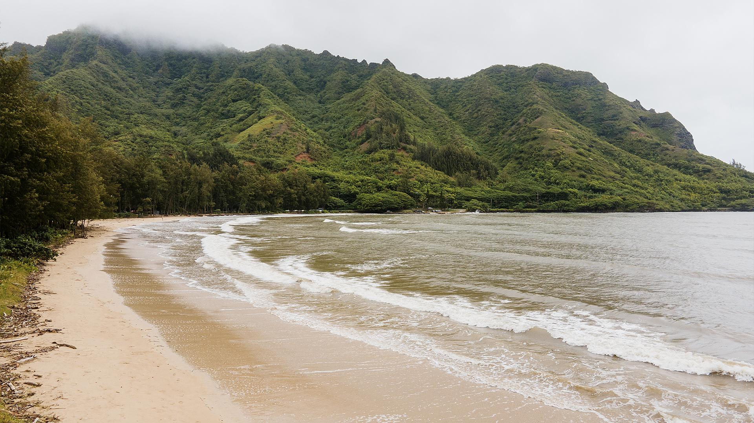
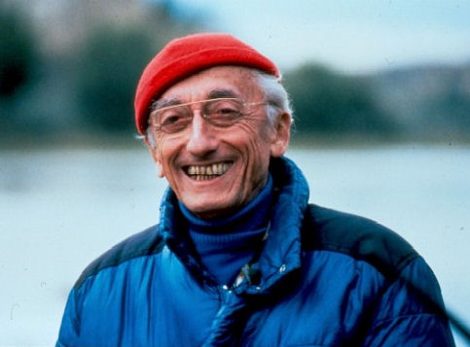
Biography
Cousteau was born on 11 June 1910, in Saint-André-de-Cubzac, Gironde, France and died on 25 June 1997. On 12 July 1937, he married Simone Melchior, his business partner. They have two sons and thats sons take part in the adventures of the Calypso.
In 1991, six months after his wife Simone's death from cancer, he married Francine Triplet. They already had a daughter and son, who was birth while Cousteau was married in his first wife

Slide 3
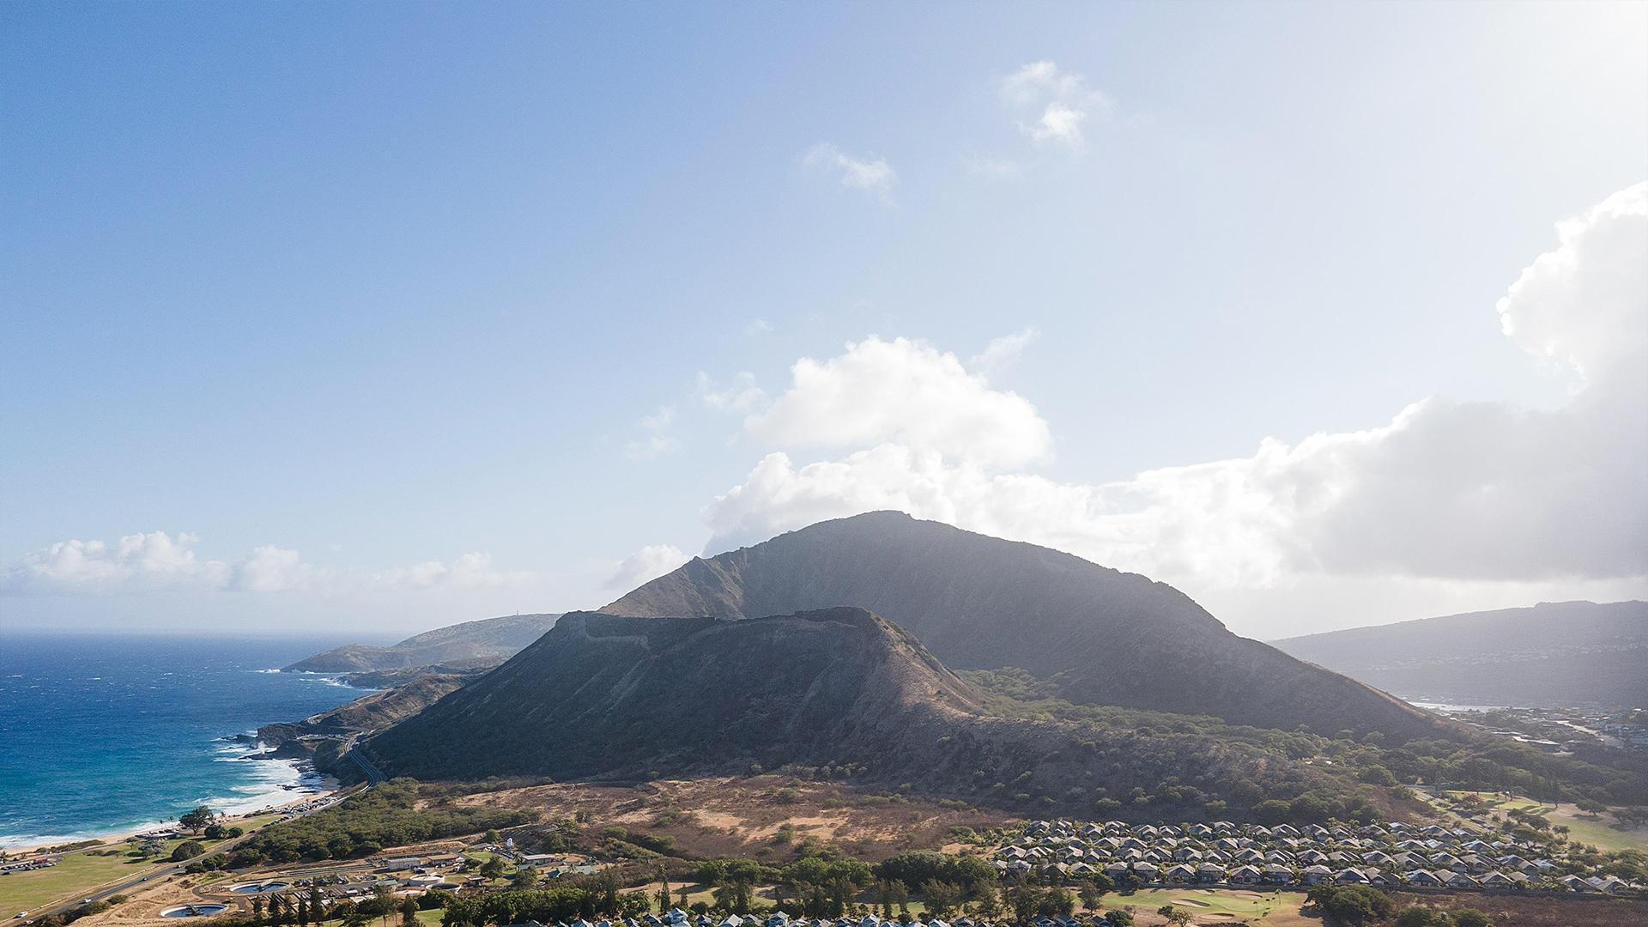
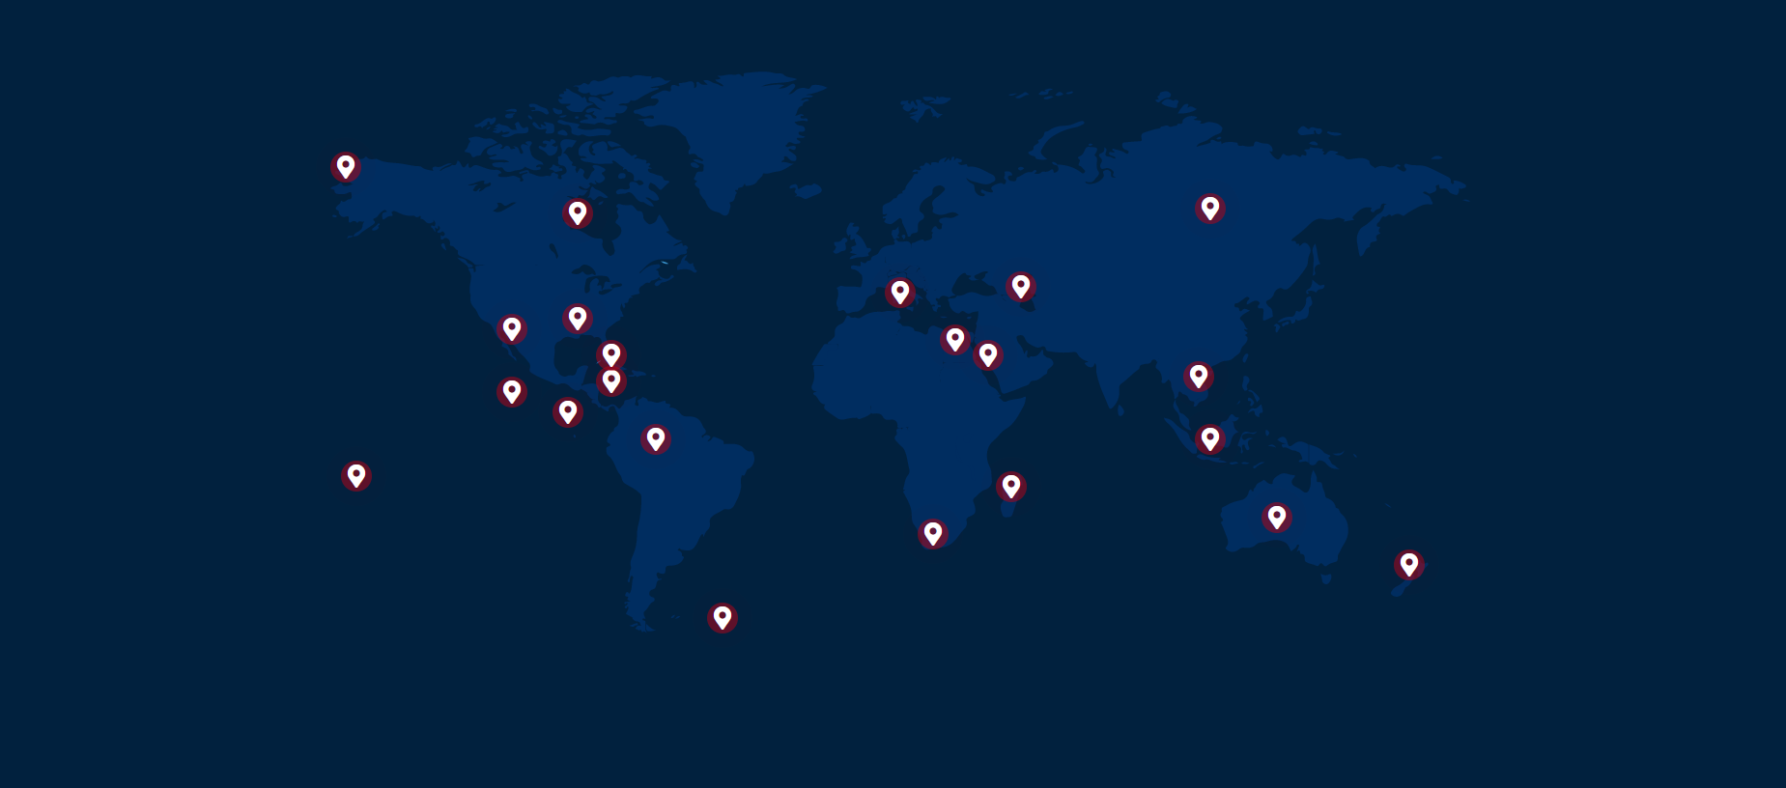
Map of his expeditions

Slide 4
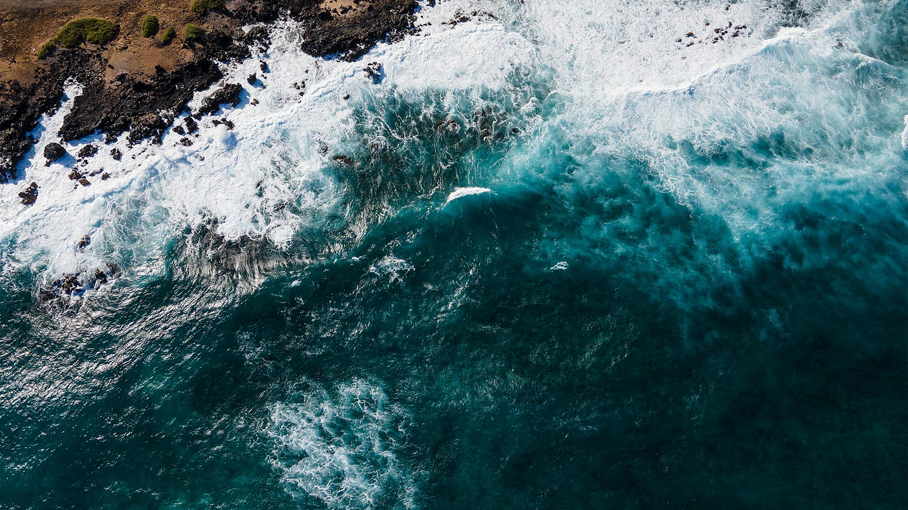
Expeditions
Alaska
Canada
Madagascar
1989
«You can walk for days on end without meeting another living soul»
In the early 1980’s
«The Nature that the crew encountered was grandiose, but also damaged»
1994
«A future harmony between humans and Nature was still possible»
Mississippi
Caribbean Sea
Nile
1983
«From the air, a flying team recorded the broad sweep of the Mississippi, dubbed the “Father of Waters” by the Indians.»
1974
«Each shipwreck has a story—that of an owner, a captain, a crew…»
1979
«From its source in Lake Victoria in Uganda to the Delta at Cairo, the Nile crosses marshes and falls, bringing life wherever it flows»

Slide 5
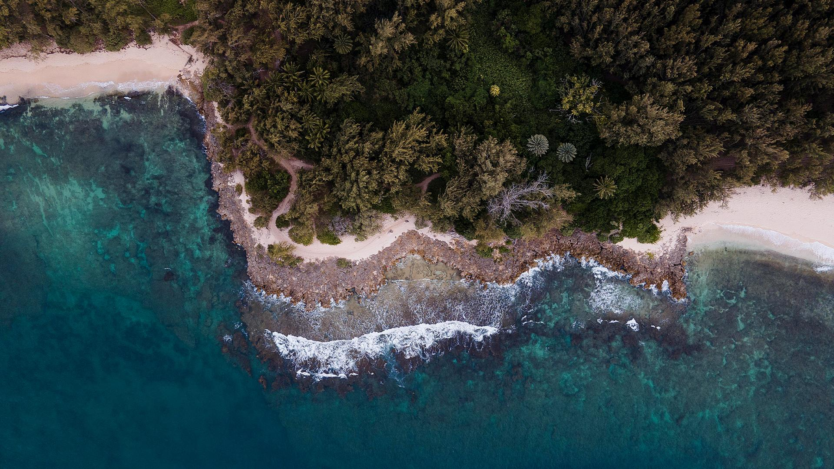
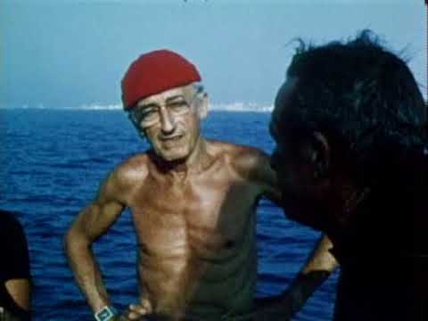
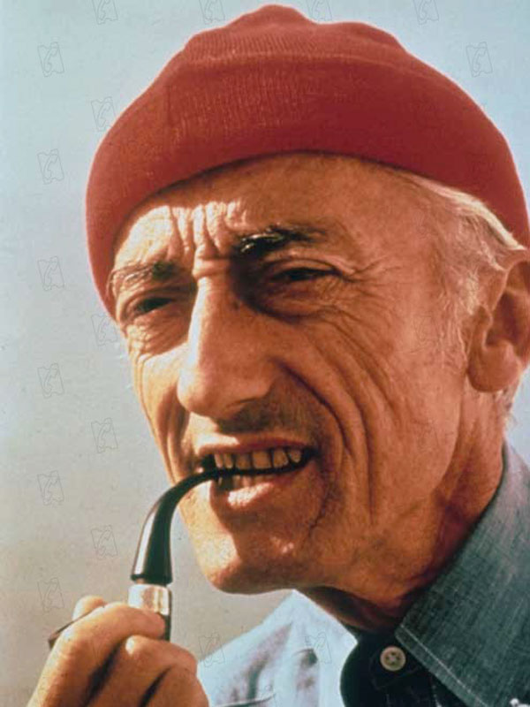
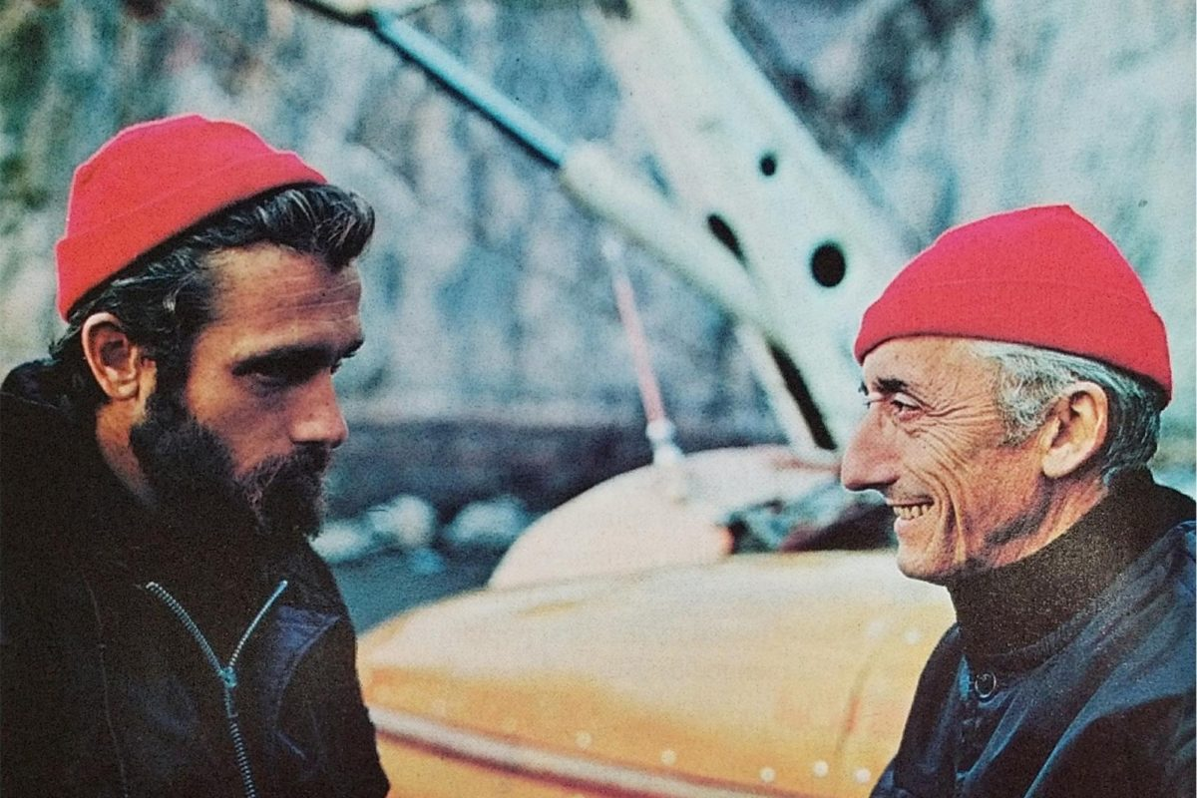
A RED HAT
Jacques Cousteau's signature red beanie was worn in homage to the 18th-century prisoners of Toulon, who were forced to test-dive the earliest metal diving suits. They had to sport red caps to differentiate them from the other port workers.
It was a woolly red hat
Cousteau gets a lot of mention on Red Hat Factory. The legend, the sea farer — or more accurately, below-sea farer — the style guru for Red Hatters across the world

Slide 6
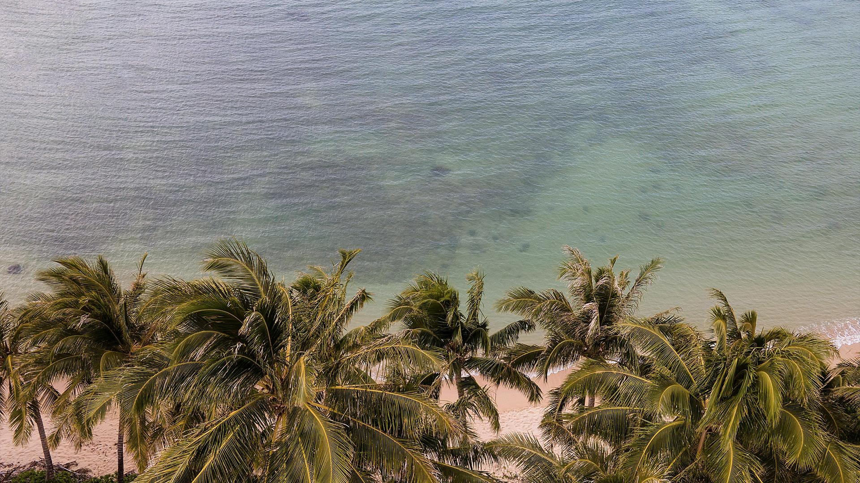
$125,000
Big numbers catch your audience’s attention

Slide 7
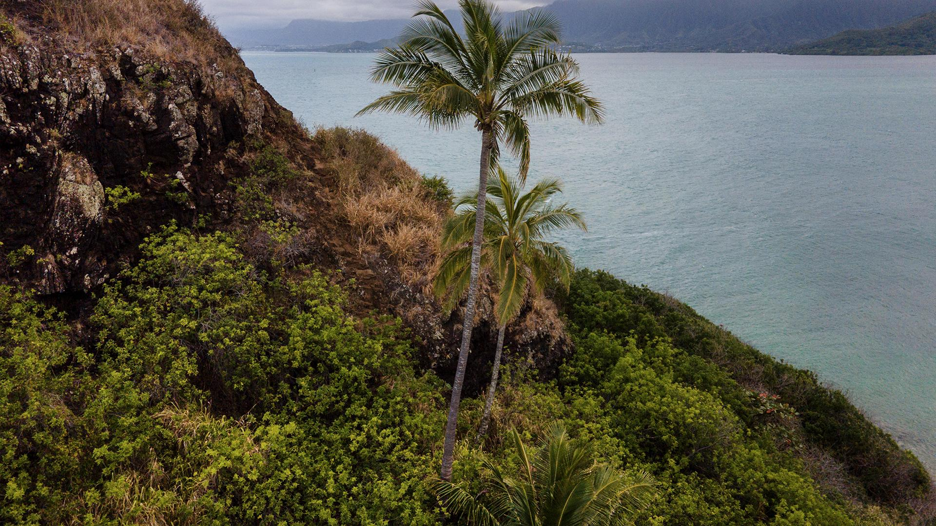
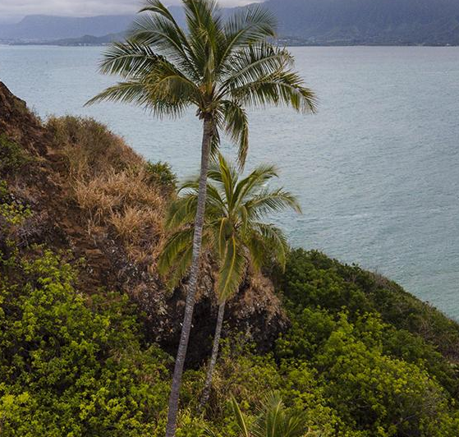
ABOUT THE PRODUCT
Do you know what helps you make your point clear?
Lists like this one:
They’re simple
You can organize your ideas clearly
You’ll never forget to buy milk!
And the most important thing: the audience won’t miss the point of your presentation

Slide 8
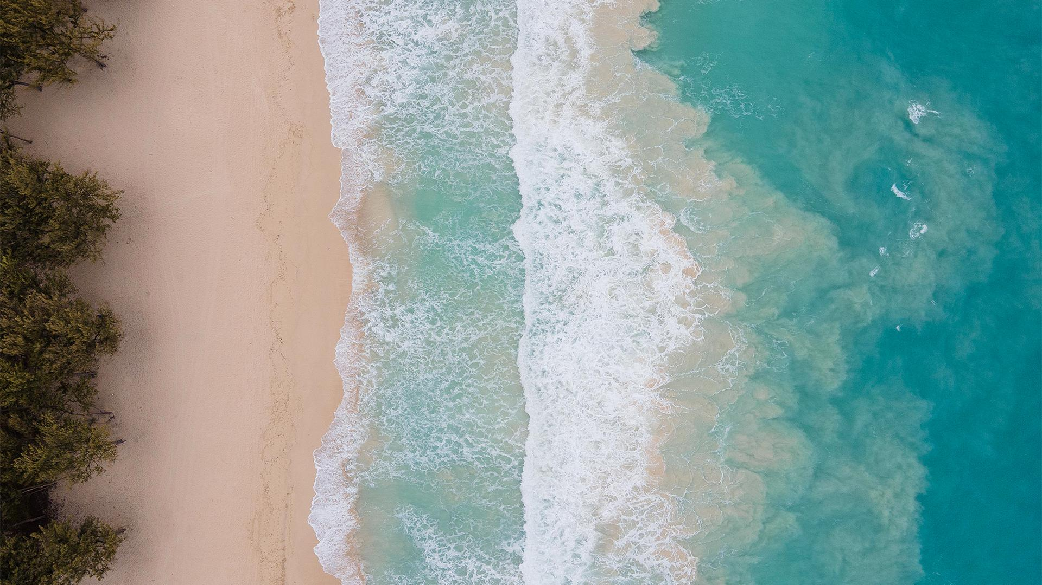
WHAT SETS US APART?
MERCURY
NEPTUNE
VENUS
MARS
It’s the closest planet to the Sun and the smallest in the Solar System
It’s the farthest planet from the Sun and the fourth-largest of them all
Venus has a beautiful name and is the second planet from the Sun
Despite being red, Mars is actually a cold place. It’s full of iron oxide dust

Slide 9
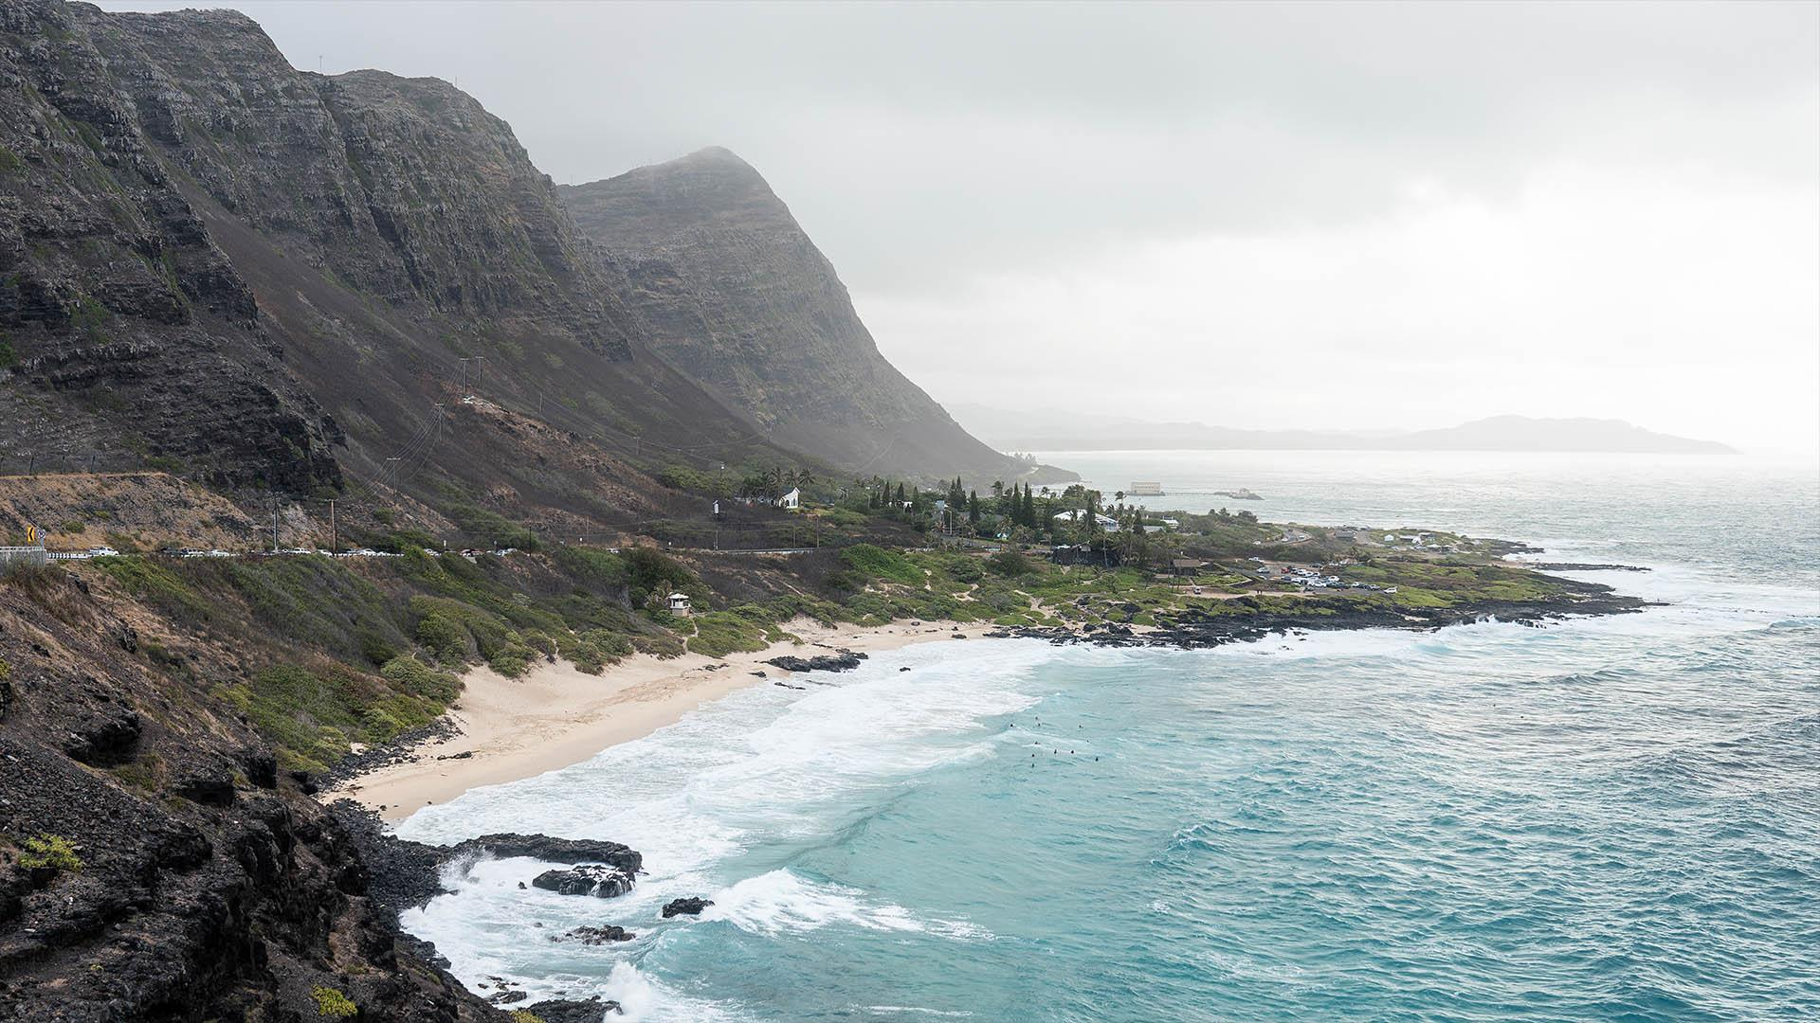
A PICTURE IS WORTH A THOUSAND WORDS
www.slidesgo.com
‘22

Slide 10
CORE VALUES
MERCURY
VENUS
MARS
JUPITER
SATURN
NEPTUNE
Mercury is the closest planet to the Sun
Venus is the second planet from the Sun
Despite being red, Mars is actually a very cold place
Jupiter is the biggest planet of them all
It’s composed of hydrogen and helium
Neptune is the farthest planet from the Sun

Slide 11
MARKET SHARE
MERCURY
It’s the closest planet to the Sun
JUPITER
VENUS
10%
25%
15%
50%
Despite being red, Mars is a cold place
Neptune is far away from Earth
The Moon is Earth’s only natural satellite
Saturn is a gas giant and has rings

Slide 12

MARKET SEGMENTATION
MERCURY
28%
Mercury is the closest planet to the Sun
VENUS
14%
Venus is the second planet from the Sun
MARS
3%
Mars is actually a very cold place
SATURN
53%
Follow the link in the graph to modify its data and then paste the new one here. For more info, click here
It’s composed of hydrogen and helium

Slide 13
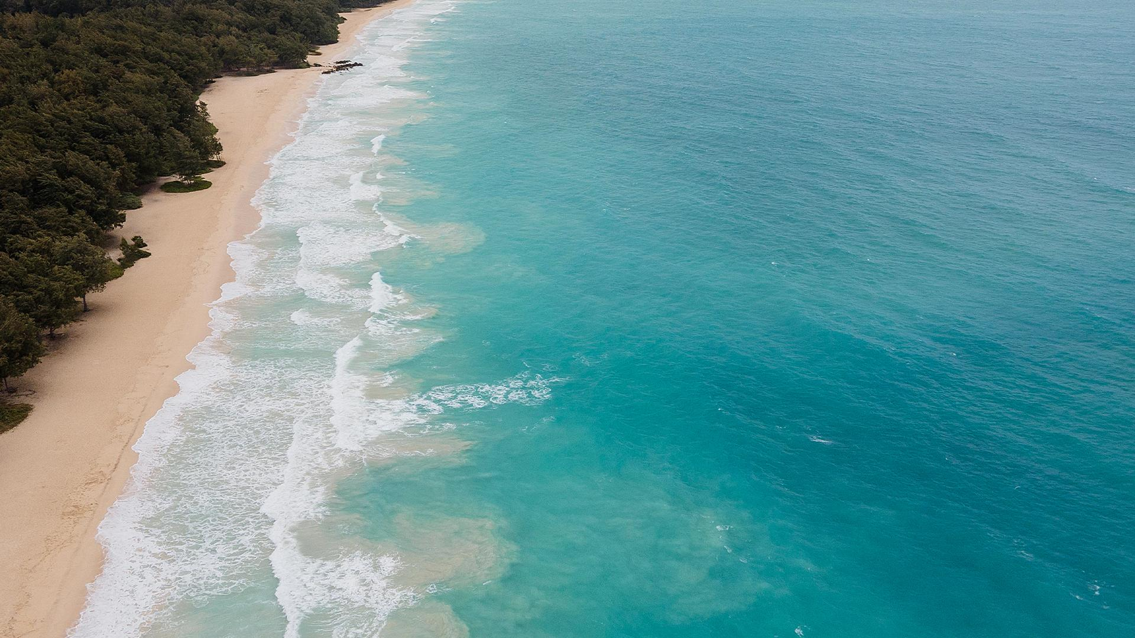
STRATEGY
STEP 1
STEP 3
Mercury is the closest planet to the Sun
The Moon is Earth’s only natural satellite
STEP 2
STEP 4
Pluto is considered a dwarf planet
Ceres is located in the main asteroid belt

Slide 14
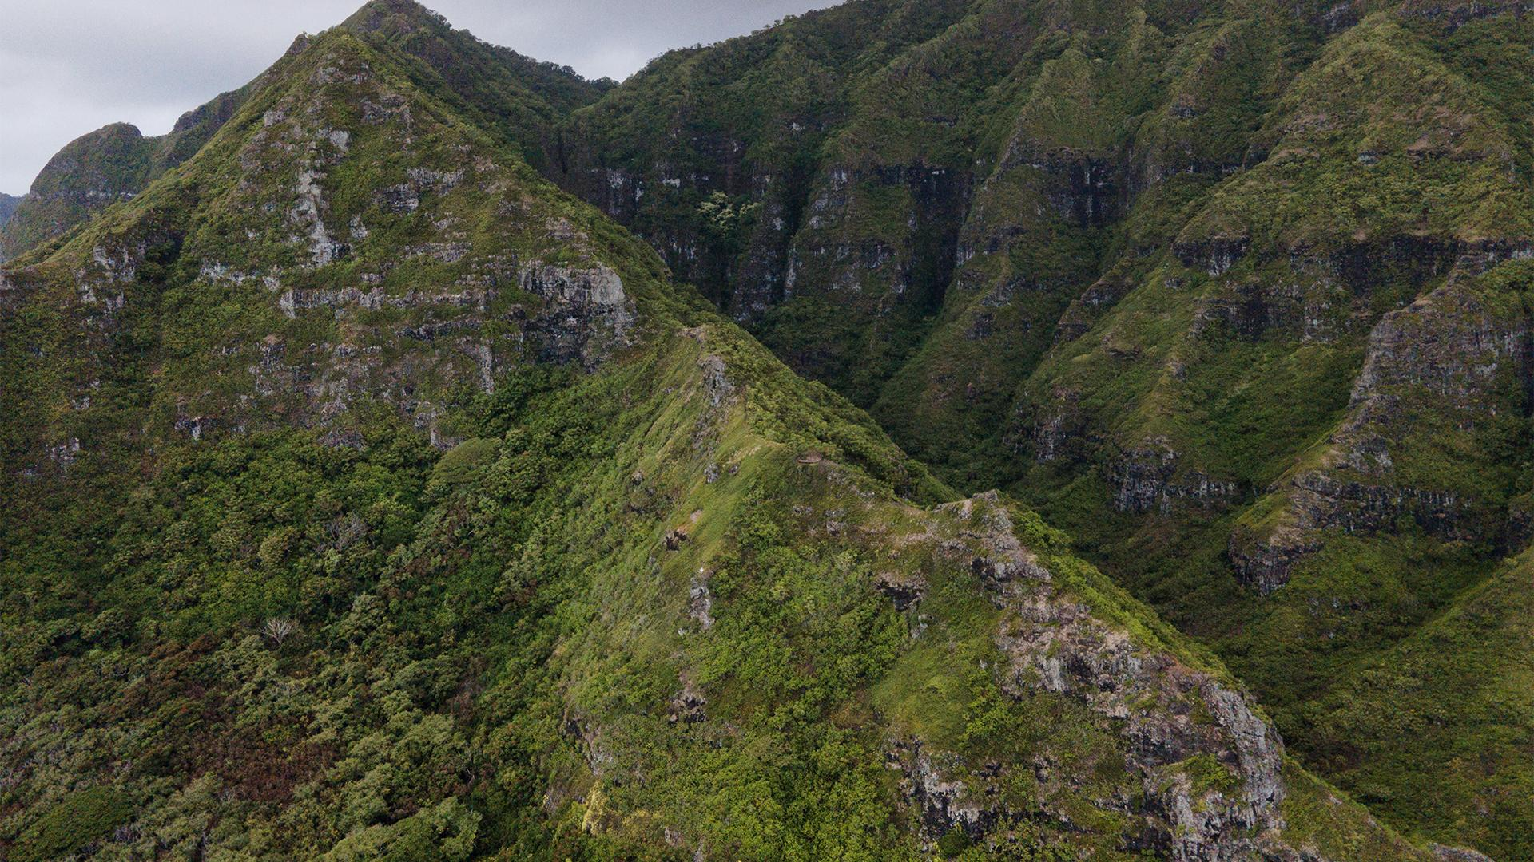
AWESOME WORDS
www.slidesgo.com
‘22

Slide 15
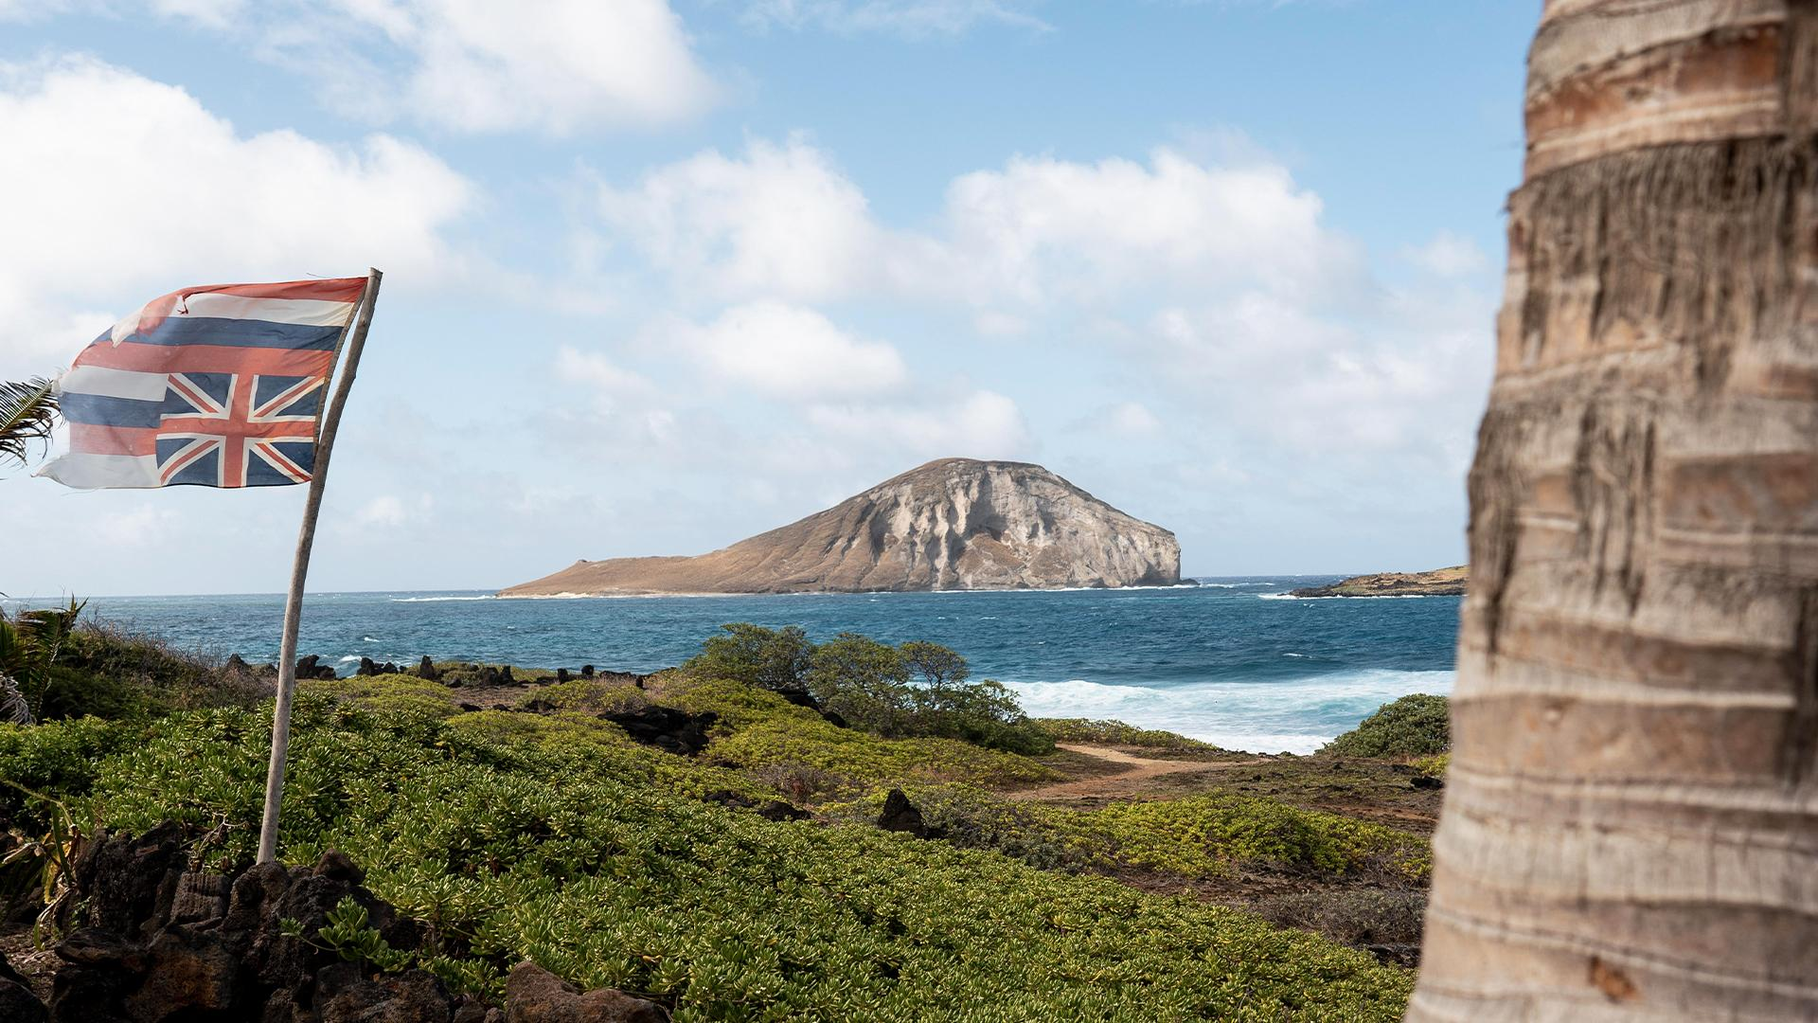
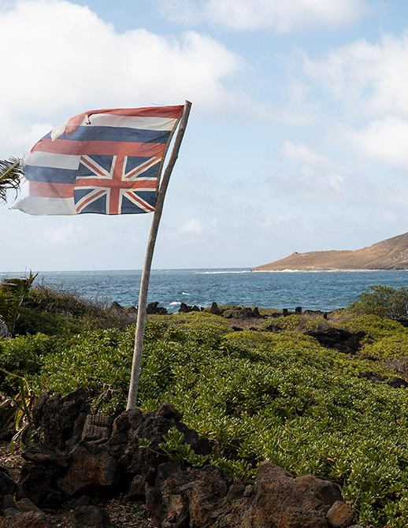
PRODUCT DESCRIPTION
MARS
VENUS
MERCURY
1
Despite being red, Mars is actually a cold place. It’s full of iron oxide dust
2
Venus has a beautiful name and is the second planet from the Sun
3
It’s the closest planet to the Sun and the smallest in the Solar System

Slide 16
PRICING
BASIC
PRO
PREMIUM
Despite being red, Mars is actually a cold place. It’s full of iron oxide dust
It’s the closest planet to the Sun and the smallest in the Solar System
Venus has a beautiful name and is the second planet from the Sun

Slide 17
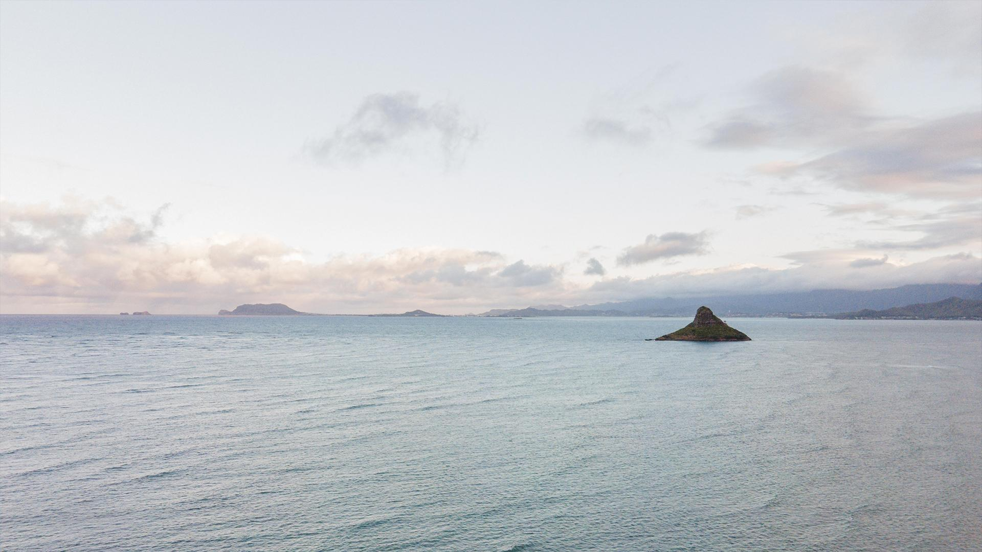
DISTRIBUTION CHANNELS
MANUFACTURER
WHOLESALER
RETAILERS
RETAILERS
The Moon is Earth’s only natural satellite
Ceres is located in the main asteroid belt
Despite being red, Mars is a cold place

Slide 18


—SOMEONE FAMOUS
www.slidesgo.com
“This is a quote, words full of wisdom that someone important said and can make the reader get inspired.”
‘22

Slide 19
PROMOTION
10%
30%
60%
Mercury is the closest planet to the Sun
Despite being red, Mars is a very cold place
Neptune is the farthest planet from the Sun

Slide 20
ADVERTISING CAMPAIGN 1
GOALS
STRATEGY
1
Neptune is far away from Earth
The Moon is a satellite
The Sun is a star
Earth harbors life
CHANNEL
2
Despite being red, Mars is a cold place
DESCRIPTION
$40,000,000
3
Venus is the second planet from the Sun
Budget
Jupiter is a gas giant and the biggest planet

Slide 21
ADVERTISING CAMPAIGN 2
DESCRIPTION
CHANNEL
$10,000.000
Neptune is the farthest planet from the Sun and the fourth-largest of them all
Saturn, the ringed planet, is composed mostly of hydrogen and helium
Big number
STRATEGY
GOALS
You can list your goals
You can list your goals
You can list your goals
You can list your goals
You can list your goals
40%
60%
Neptune
Jupiter

Slide 22
PR OUTREACH
MEDIA CHANNELS
GOALS
Jupiter
Saturn
Moon
Venus
10%
Mercury
20%
15%
35%
50%
Neptune
KEY MESSAGES
30%
The Sun is a bright star
Mars is actually a cold place
Earth is the third planet from the Sun
Venus
40%

Slide 23
BUDGET ALLOCATION
MERCURY | VENUS | JUPITER
- | $41,000 | -
$12,000 | $23,000.000 | -
$30,000 | - | $120,000
$7,000 | $68,000 | $40,000.000

Slide 24
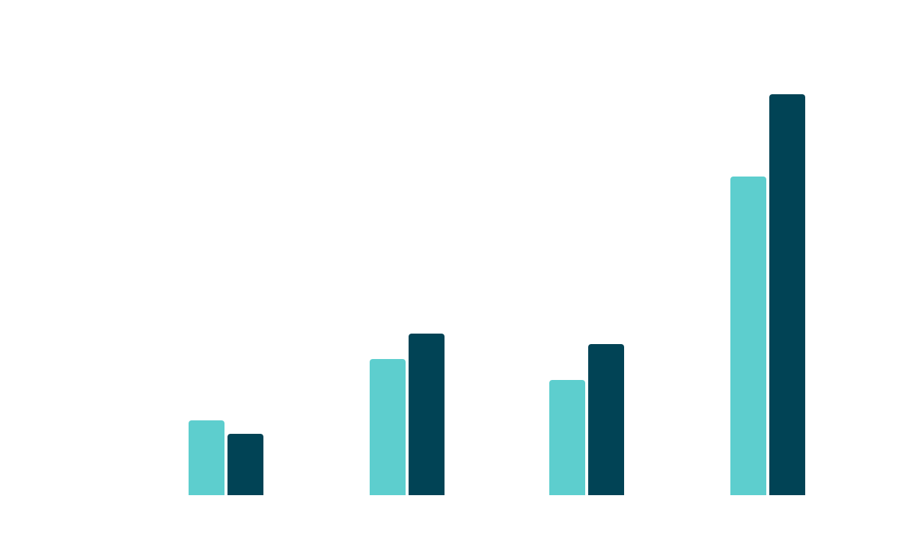
PREDICTED REACH
The Moon is Earth’s only natural satellite
MOON
MERCURY
Mercury is the closest planet to the Sun
MOON
The Moon is Earth’s only natural satellite
CERES
Follow the link in the graph to modify its data and then paste the new one here. For more info, click here
Ceres is located in the main asteroid belt

Slide 25
TIMELINE
MERCURY
CERES
1
2
Mercury is the closest planet to the Sun
Ceres is located in the main asteroid belt
MOON
VENUS
3
4
The Moon is Earth’s only natural satellite
Venus is the second planet from the Sun
PLUTO
MARS
5
6
Pluto is considered a dwarf planet
Despite being red, Mars is a cold place

Slide 26
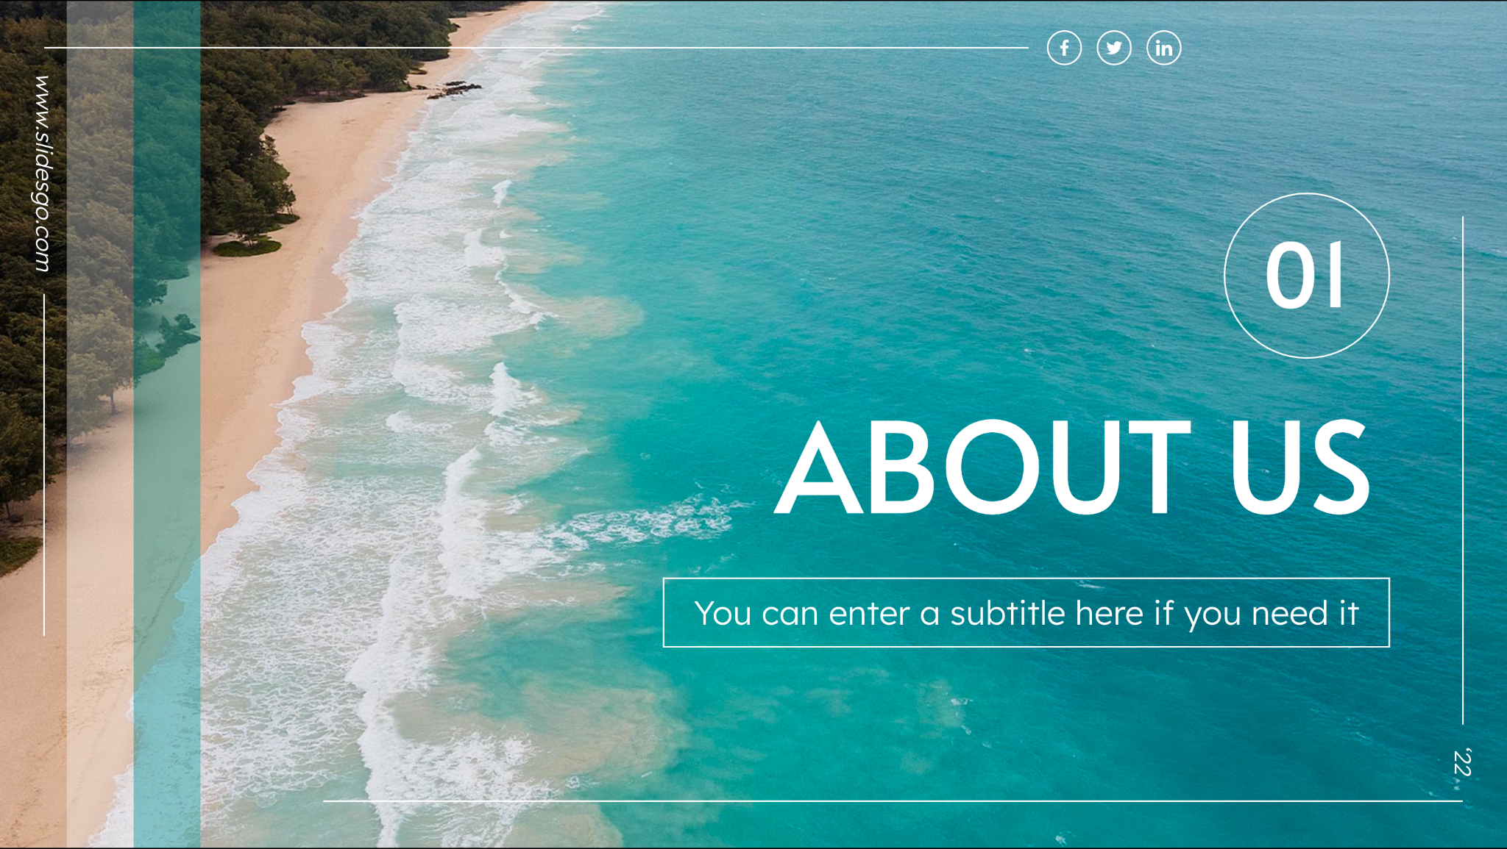
MULTIMEDIA
Insert your multimedia content here

Slide 27

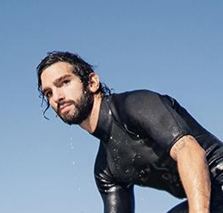
OUR TEAM
JENNA DOE
TIMMY JIMMY
You can speak a bit about this person here
You can speak a bit about this person here

Slide 28
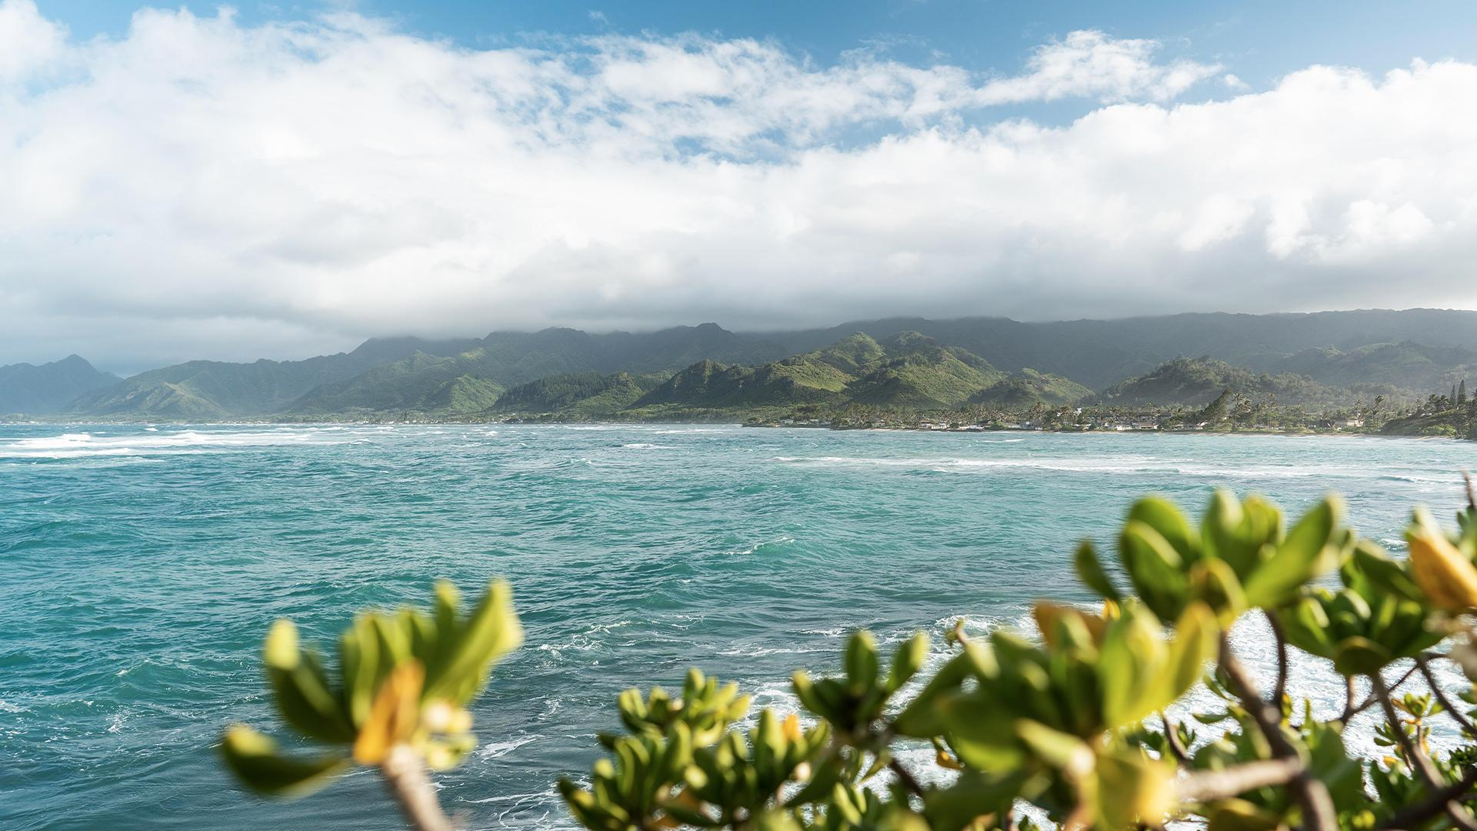
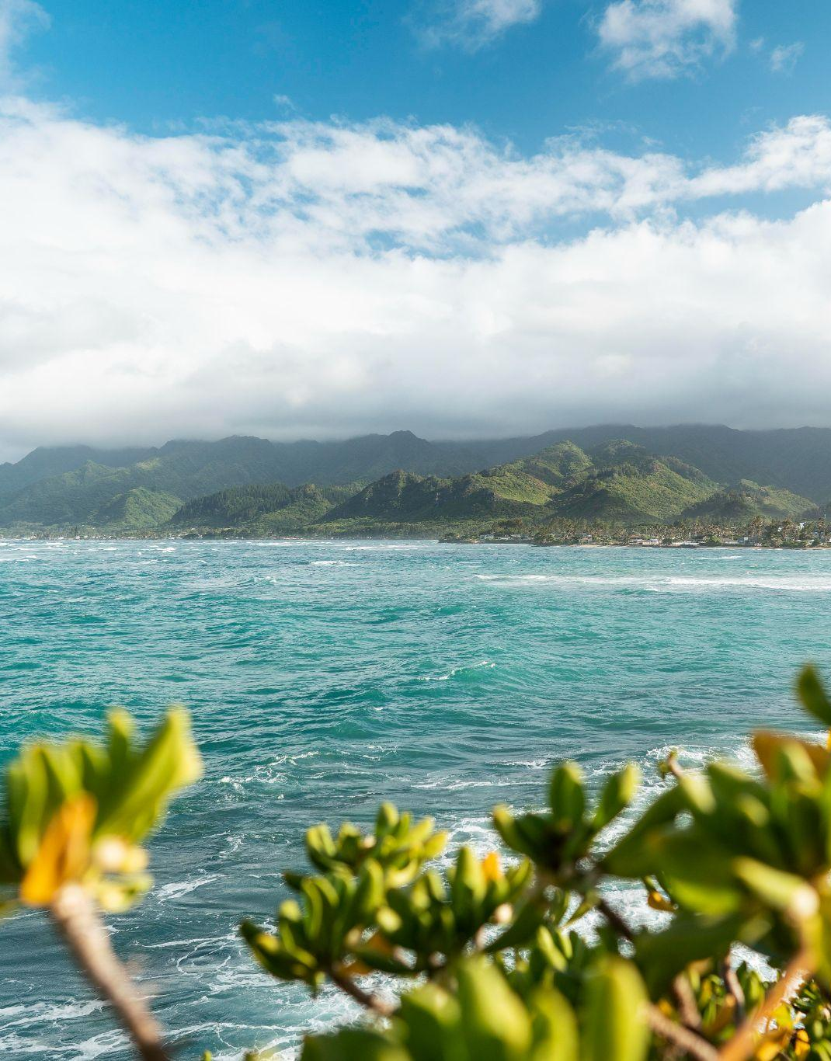
THANKS!
www.slidesgo.com
DO YOU HAVE ANY QUESTIONS?
youremail@freepik.com
+91 620 421 838
yourwebsite.com
Please keep this slide for attribution
‘22

Slide 29


